Slide 1
Client part
Client #1
Client #2
Client #3
…..
Server part
Reference Table
(Cache Data)
DNS Server
DNS Root Server

Slide 2






Reference Table
Query
User
Key Value Searching …

Slide 3
+10
+10
120 (1) | 110 (2) | 100 (3) | 150 (4) | 160 (5) | 50 (6) | 11 (7)
…….
240
330

Slide 4

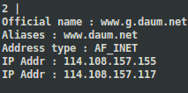
+10
+10
120 (1) | 110 (2) | 100 (3) | 150 (4) | 160 (5) | 50 (6) | 11 (7)
…….
240
330
0
154
User
Return Query Info

Slide 5

UPDATE
Read
Write
Temp Array SET
(key, request count, domain name)

Slide 6




Query List(Future)
www.naver.com
www.google.com
……
…
Worker count : 3
Worker count : 8
Case 1
Case 2

Slide 7
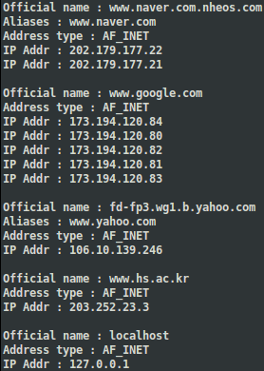

User
www.naver.com
www.google.com
……

Slide 8
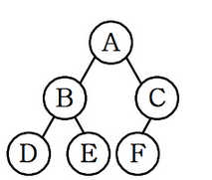
Case 1
Case 2

Slide 9

파일에 대한 순차검색
힙 정렬의 비용

